Slide 1
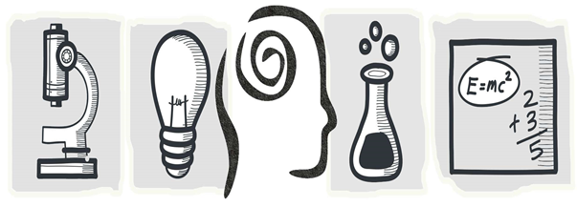
Understanding of everyday awareness and scientific concepts in natural science subjects(STEAM)
Uldis Heidingers
Mg.sc.ing., Teacher in Riga State Technical school

Slide 2
Term
A word or word combination that denotes a definite concept and that has a dedicated meaning and sphere of usage

Slide 3
Concept
Reflection of essentia features of subjects/phenomena/ objects in awareness.

Slide 4
Definition
A concentrated formulation of understanding the concept that usually contains its essential features and makes it different from other connected concepts.

Slide 5
Programs of educational subjects:
«Know the term…….»
«Know the definition of the concept…….»
«Undesrstands the concept……..»
«Use the term…….correctly.»

Slide 6
The term 'Isotope
The atoms of one chemical element the nuclei of which contain an identical number of protons but a different number of neutrons are called isotopes. .

Slide 7
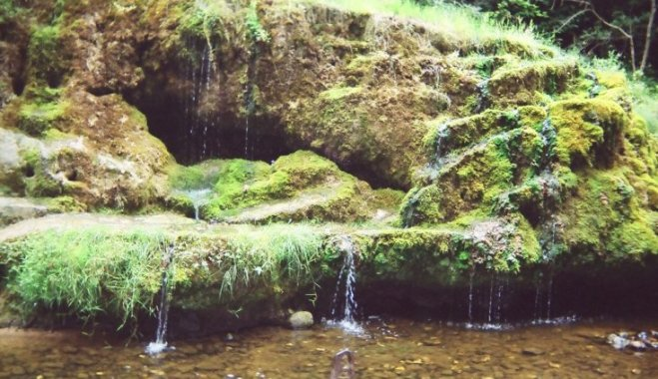

Slide 8
Terms
(in accordance with the way of understanding the concept)
Is obtained through the process of practical experience
……?……
Is based on logical but indirect connections

Slide 9
Associations
Association - connection of 2 or more objects in one's awareness. The origin of various types of associations / depends on the material that stimulates it/
similar and contrasting associations
associations of cause and effect;
associations of contact in space and time.

Slide 10
A model is an associative image that shows some similarity of nature, technical sciences or mathematical concept, process or phenomena with some object, process or phenomenon in everyday life or nature. .

Slide 11
A model as a teaching material is created by a student independently and individually.
After that the model can be used by other students under the guidance of the teacher.

Slide 12
Pairs ' concept- association

Slide 13
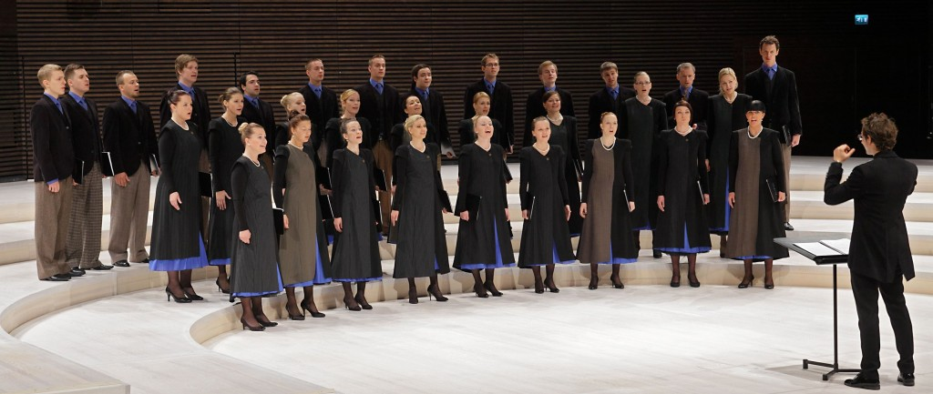
Catalyst

Slide 14
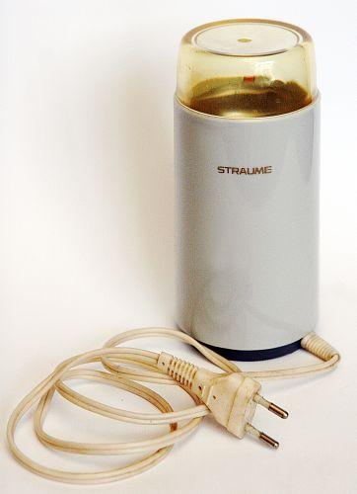
Analogous organs

Slide 15
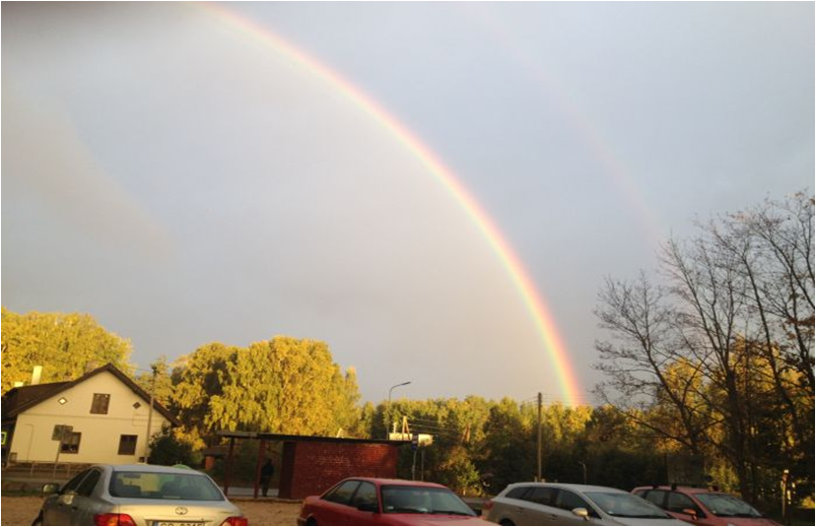
Reflex

Slide 16
Process? Phenomenon? Quantity? …
PROCESS- continuous coherent interchange of closely connected development stages, phenomena, conditions into other stages..
PHENOMENON- any visible event..
QUANTITY- totality that can be expressed into units of measurement,it can be calculated..

Slide 17
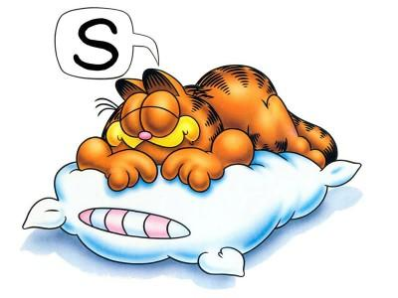
Garfield is sleeping. His wish to wake up is opposed by sleep. The same way friction disturbs any motion

Slide 18
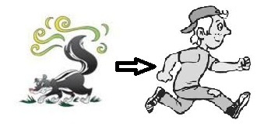
the skunks have a self-protection method. When approaching them they secrete a very unpleasant smell that frightens everyone away. In this case the skunk is like a magnet but the possible enemy- a diamagnet that is repulsed.

Slide 19
Group activity 'The formation of a model.'

